Slide 1
“You’re still on the fastest route. Would you like to proceed?”
Investigating changes in primary health care access in Hawke’s Bay, New Zealand, following Cyclone Gabrielle
Grace Sokolow
April 2024

Slide 2
today
Public health
Social geographies
Extreme events
Computational methodologies

Slide 3
Climate change and extreme weather

Slide 4
Research questions
1. How did road access to primary health care facilities change before and after Cyclone Gabrielle?
2. What characterizes the communities affected?

Slide 5
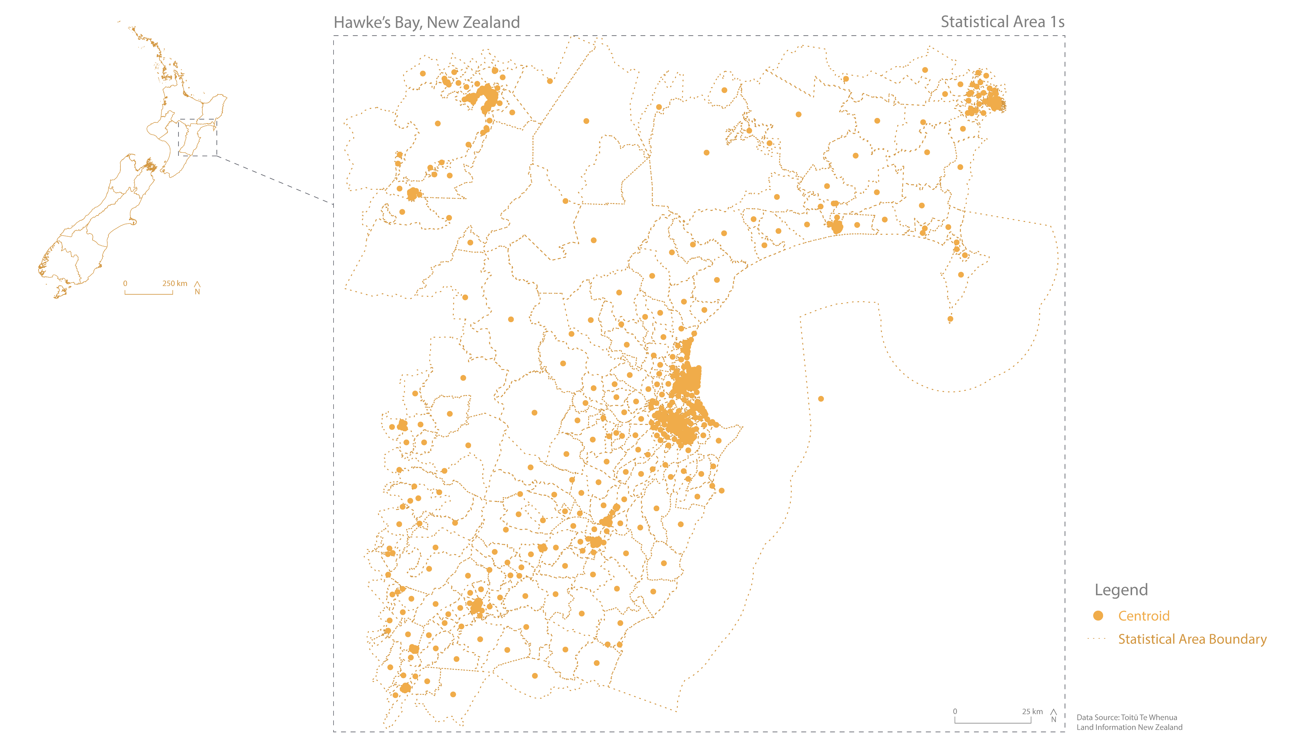

Slide 6
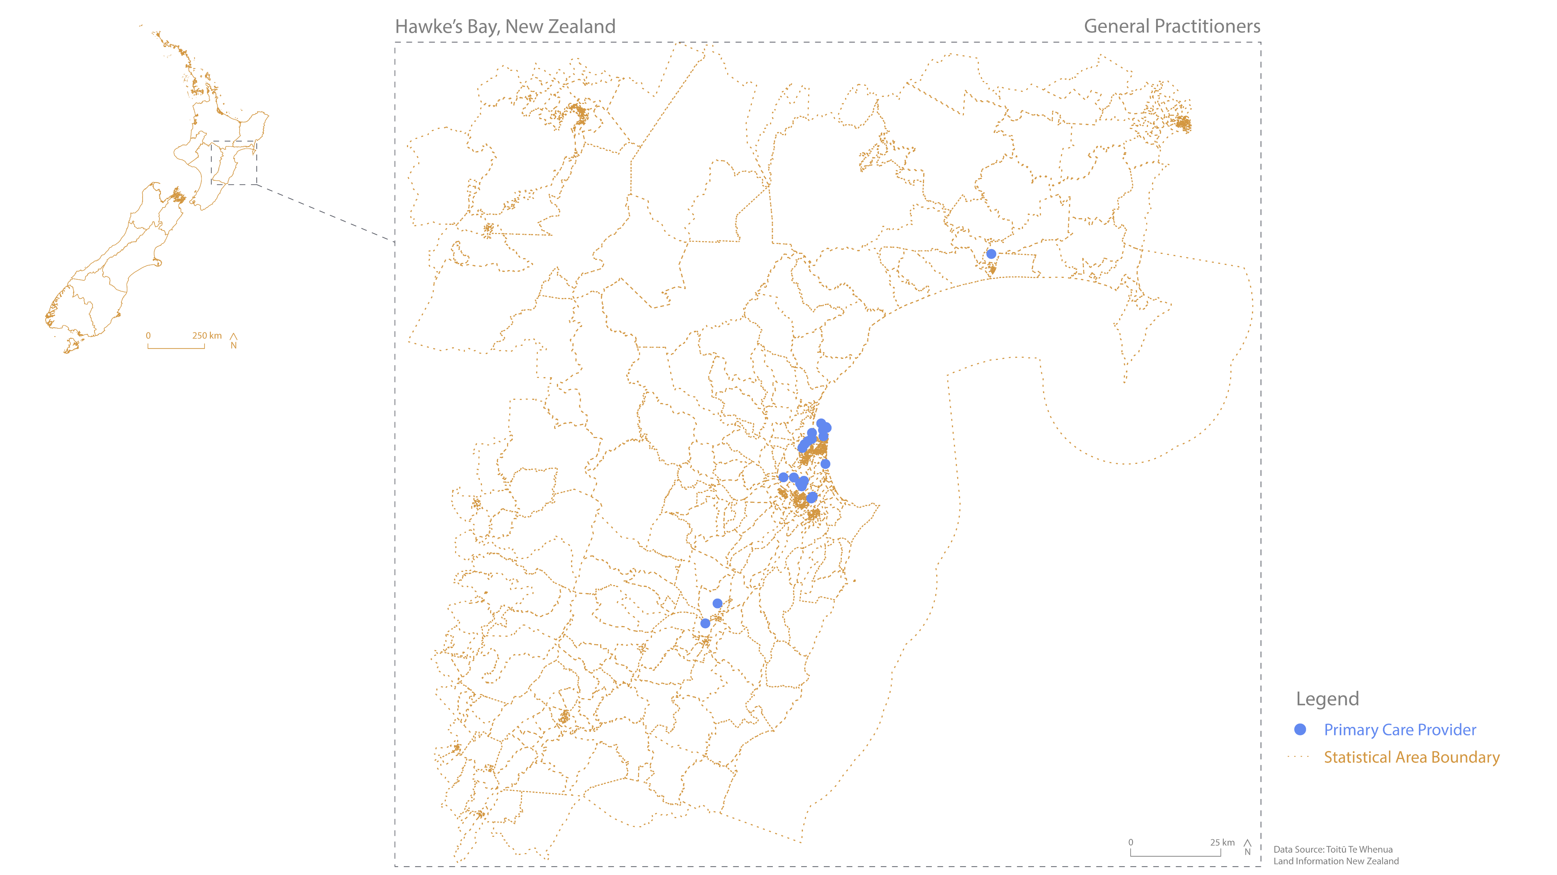

Slide 7
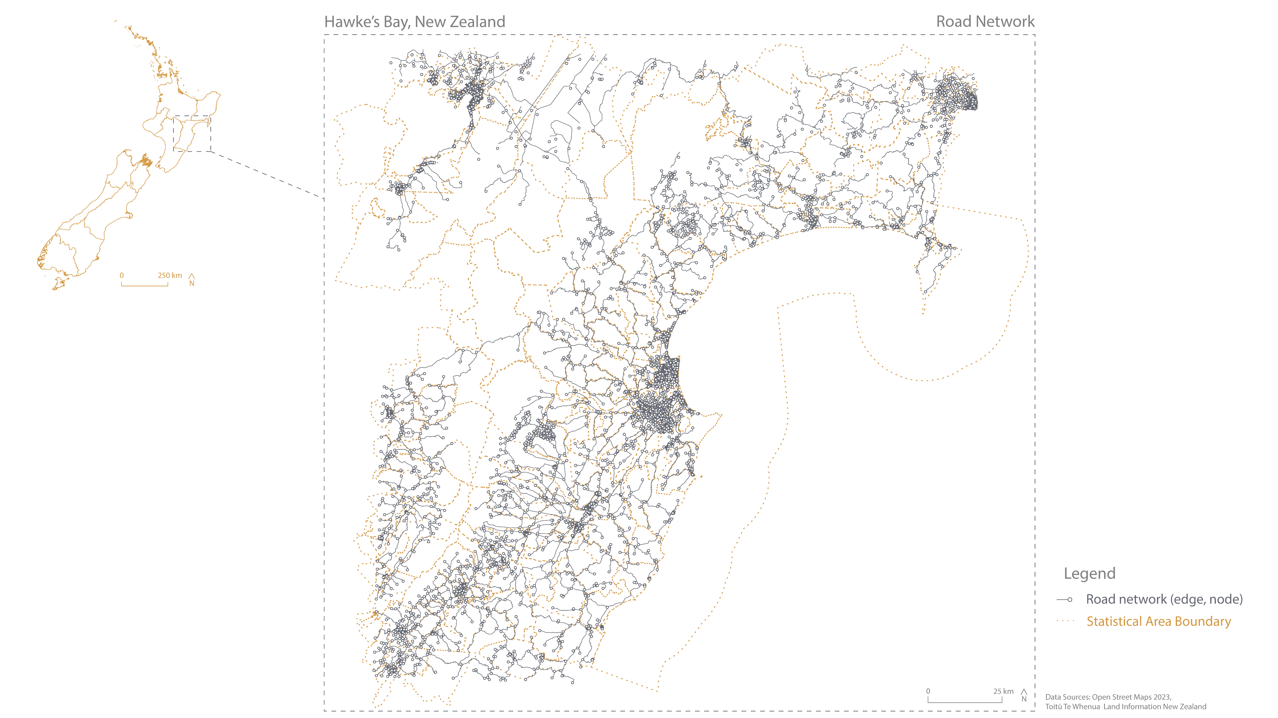

Slide 8
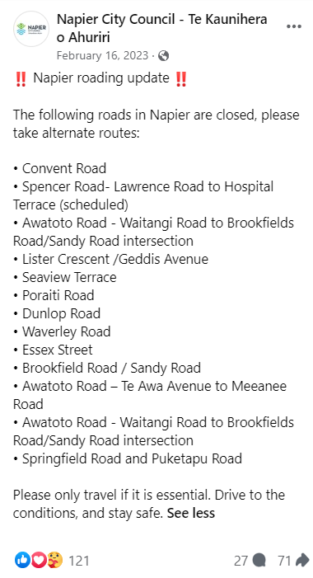
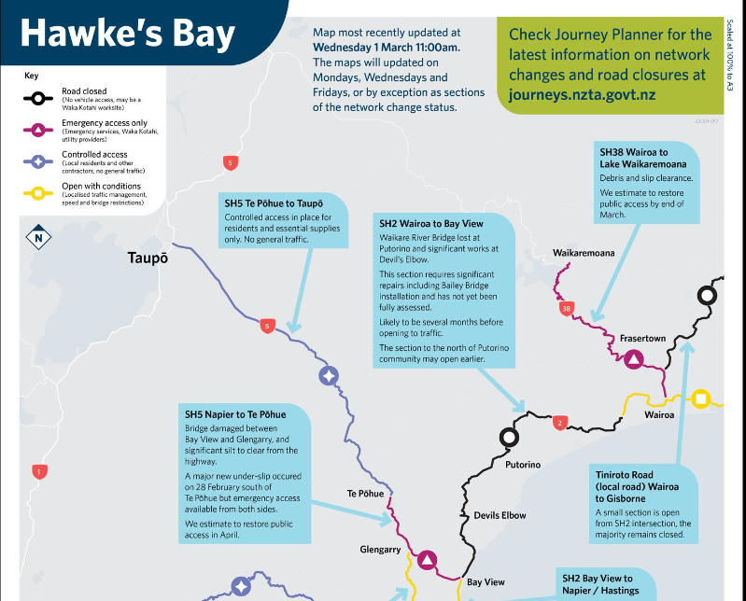
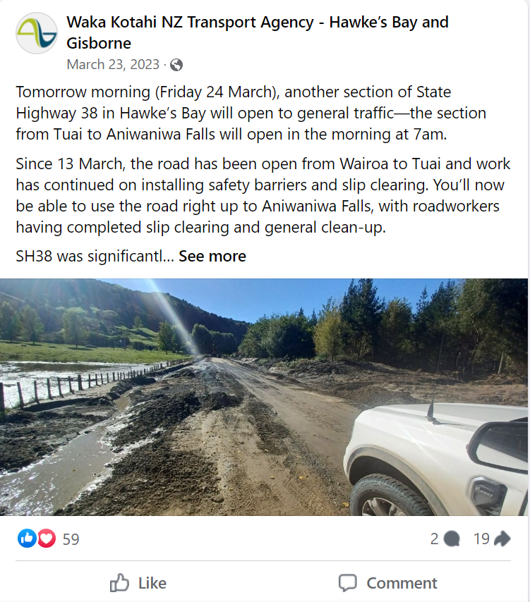
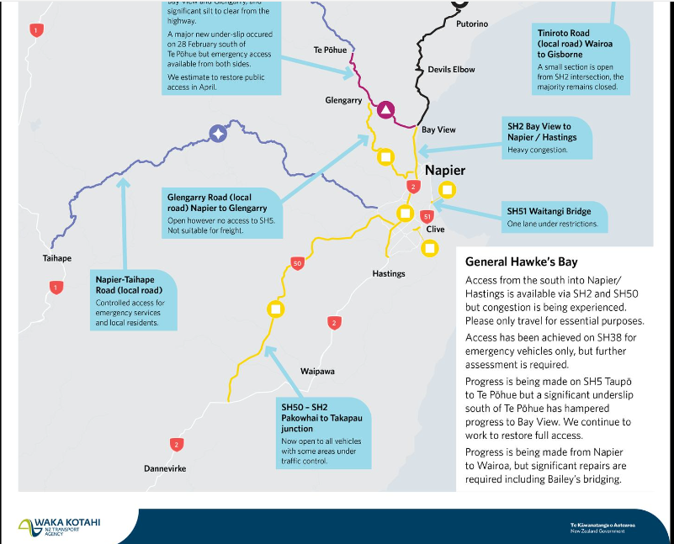


Slide 9
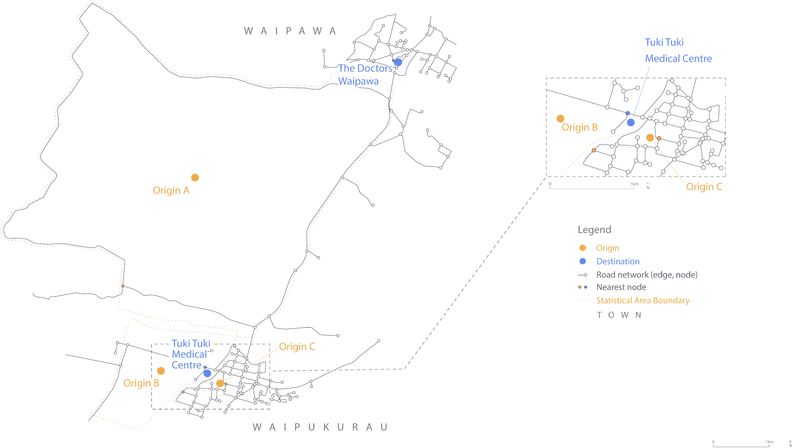

Slide 10
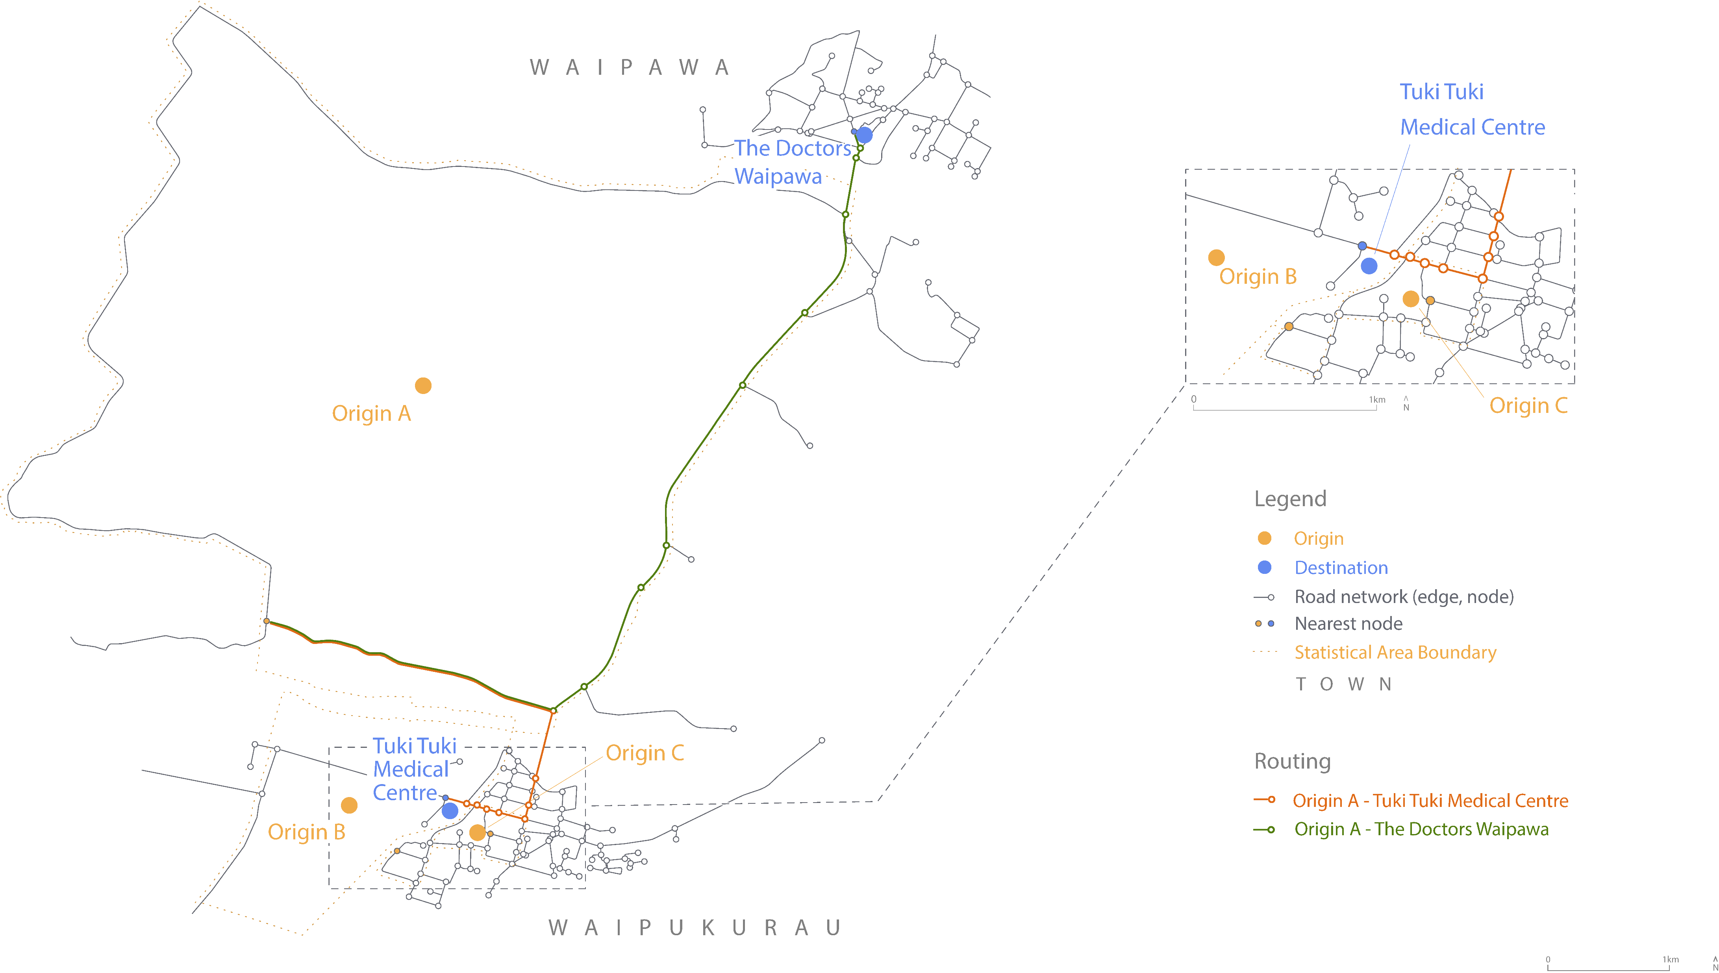

Slide 11
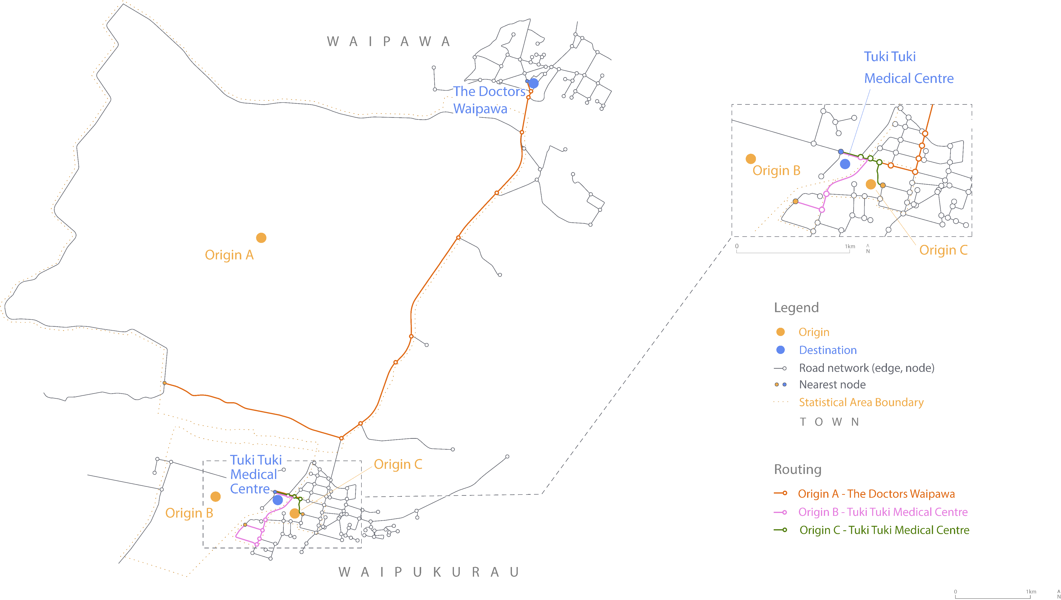

Slide 12
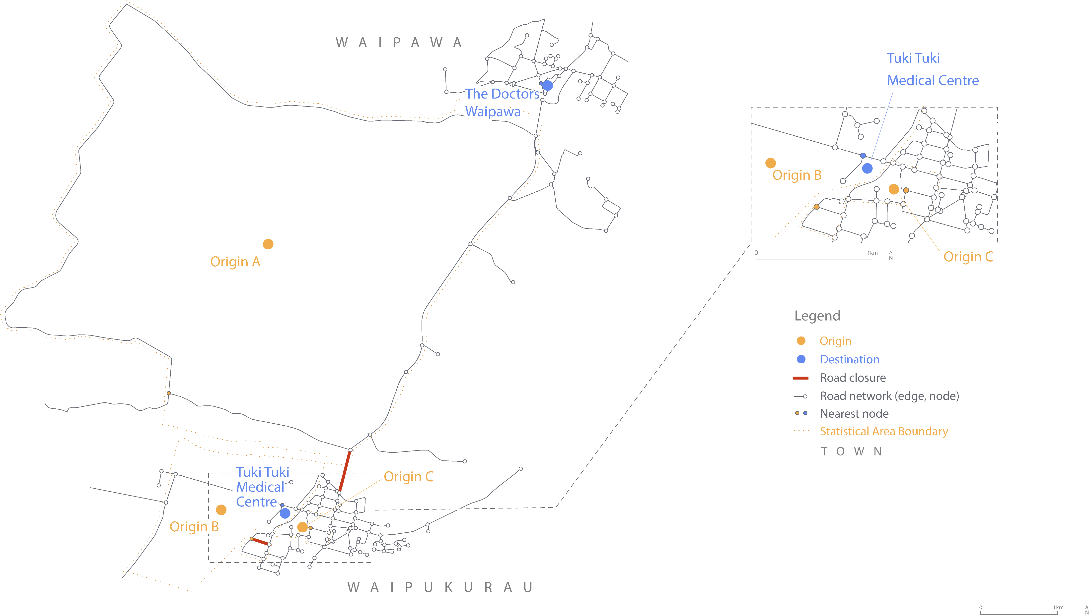

Slide 13
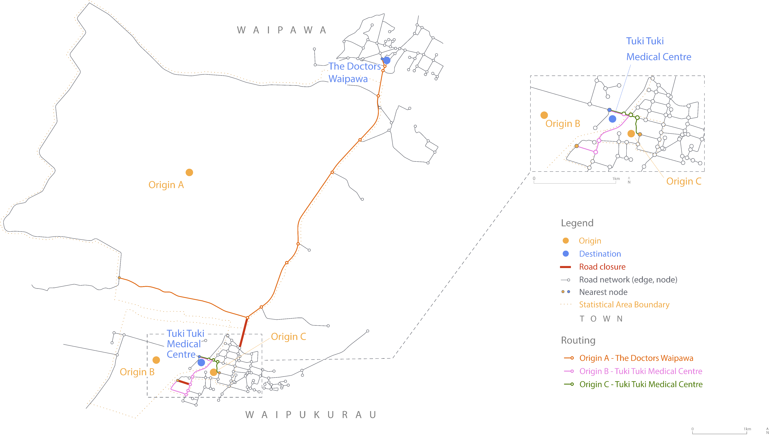

Slide 14
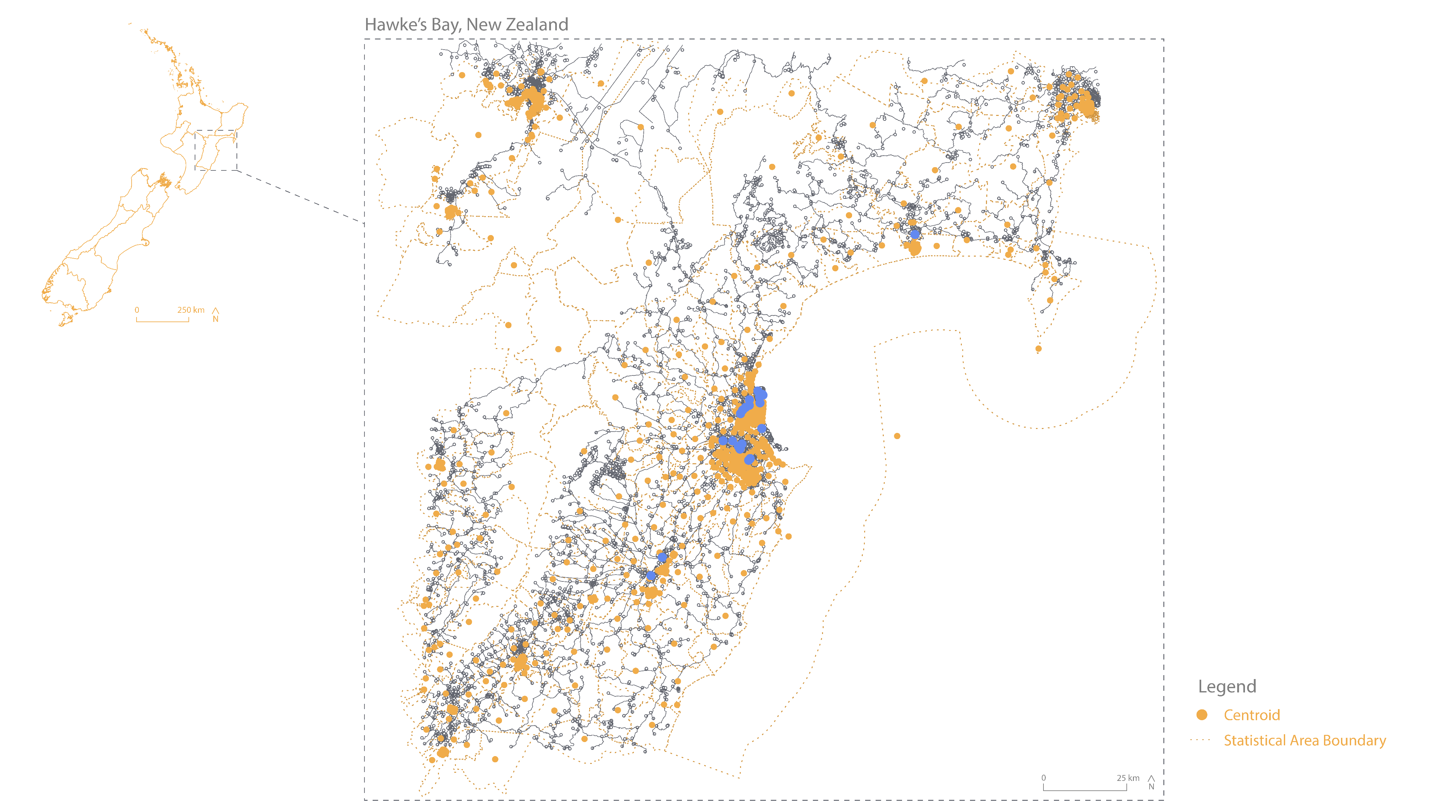

Slide 15
Map showing pct maori/pacifica/low income
Premise is that they are unevenly distributed

Slide 16
We see these changes: figure showing which SA1s changed providers, and which changed distance

Slide 17
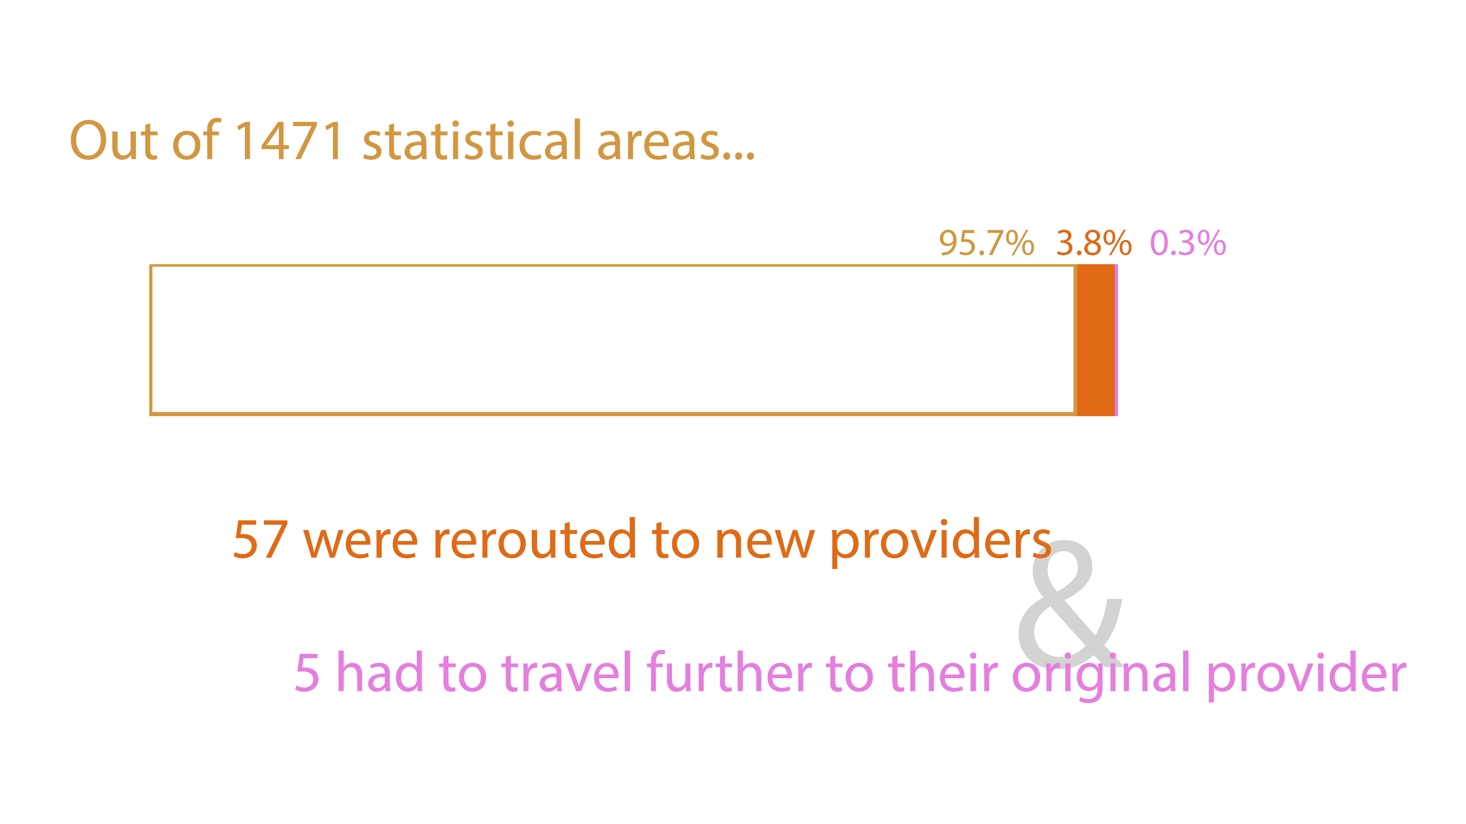

Slide 18
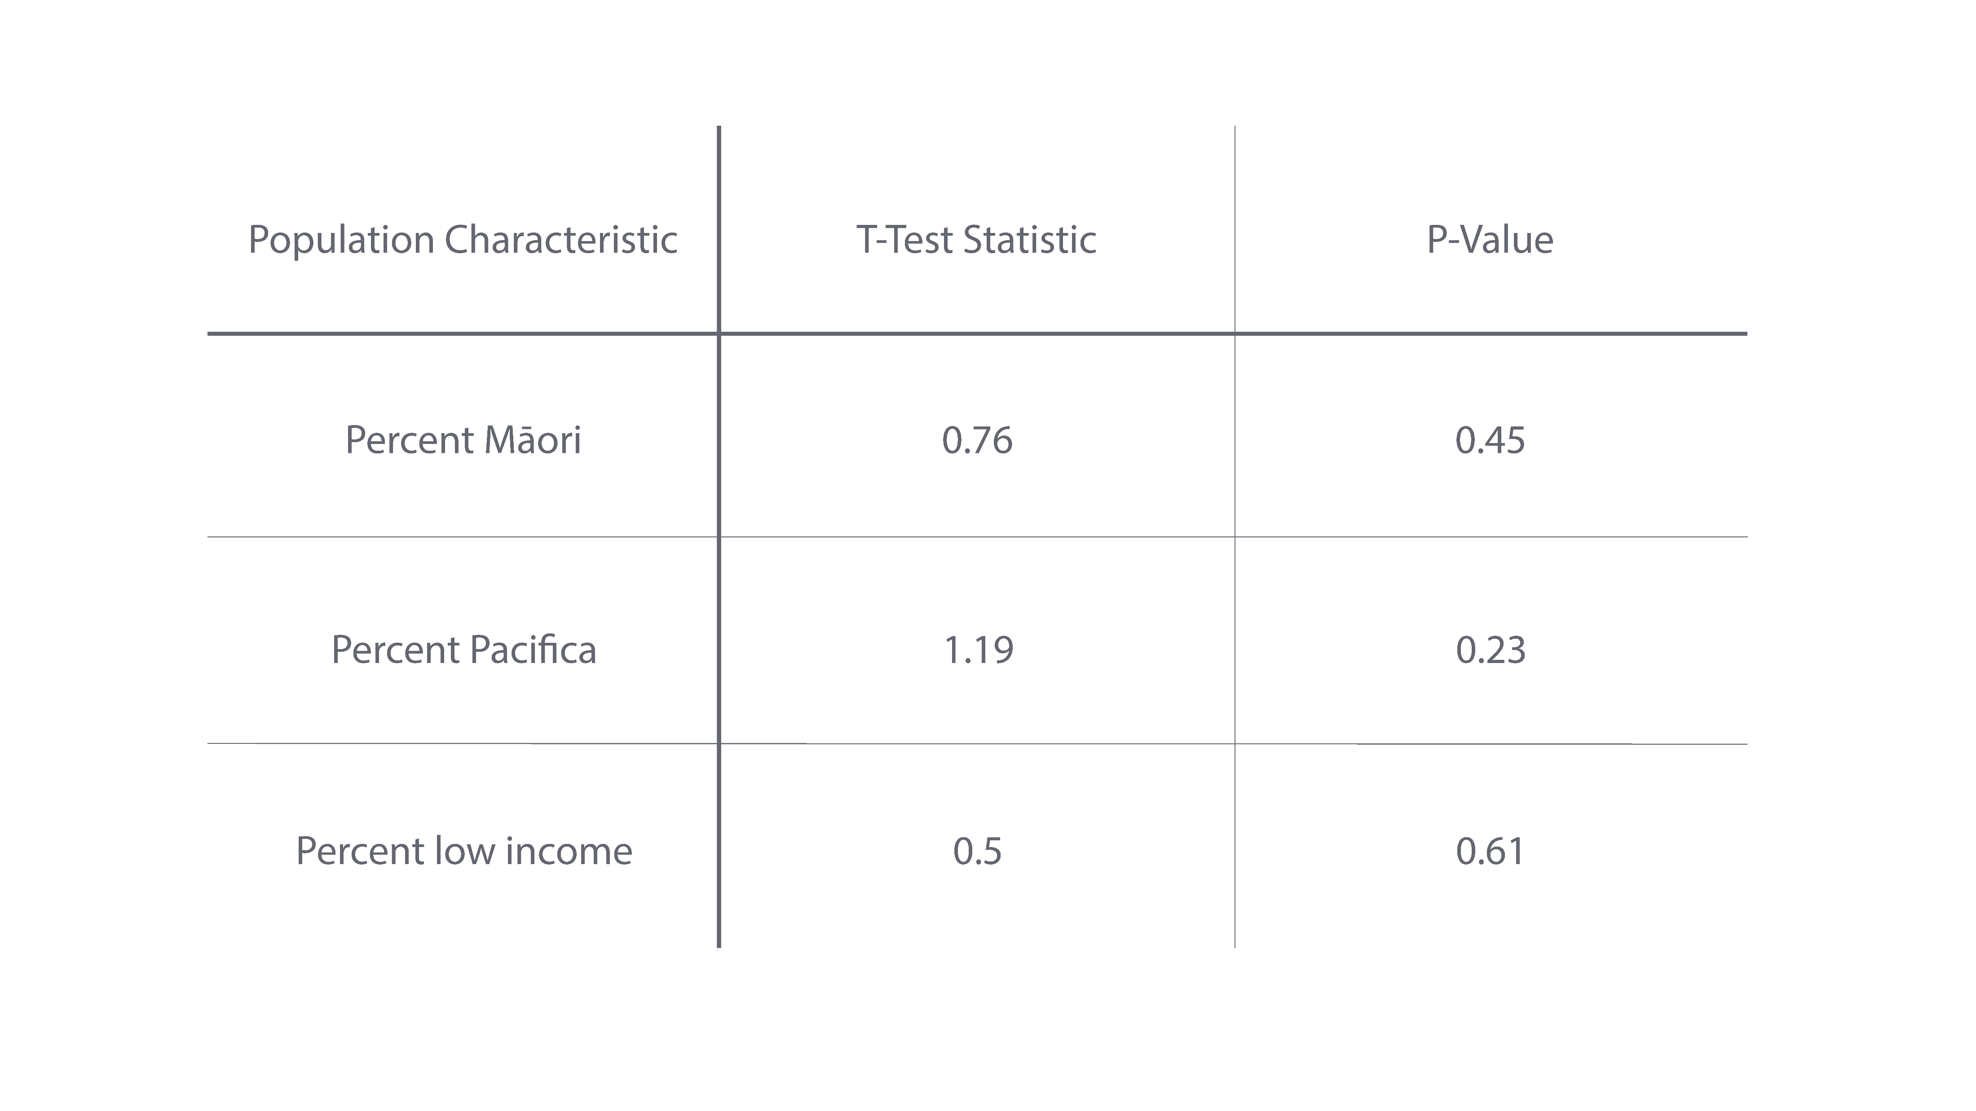

Slide 19
Potential Improvements - for the 2.0 version!
Small sample size of road closures (only 7 implemented)
Methodology of closing roads (1 segment, subjectively placed along closure route)
Centroid generation and placement
Not weighted by population
Not constrained to within the SA1
Distance to network not accounted for
Edge effects
Only looking at primary care providers in the defined region
Imperfect definition of region (conflicting borders) & doesn’t capture entire area affected
Based on model of rational human behavior (ie always going to closest provider)
Closest to what?
Potentially ignores other more pressing needs or barriers to health care access
** visualize these to extent possible

Slide 20
Uses beyond limitations
Varied applications
Road closure modeling in other places/for other storms
Vulnerability testing for specific populations
Modeling access to different amenities on different time scales
Improvements to be made
Calculating travel time rather than distance only
Addressing limitations

Slide 21
Thanks for coming!
Special Thanks to
Pete Nelson
Joe Holler
Caitlyn Myers
Pete Johnson
ALL THE NZ PEOPLE WHO RESPONDED TO ME!
The sandbox crew <3

Slide 22
References

